Slide 1
Presidential speech comparison
A Word Frequency Analysis Between Two Former Presidents annual speeches.
By: Dan Scott - Team 4 – dscott57

Slide 2
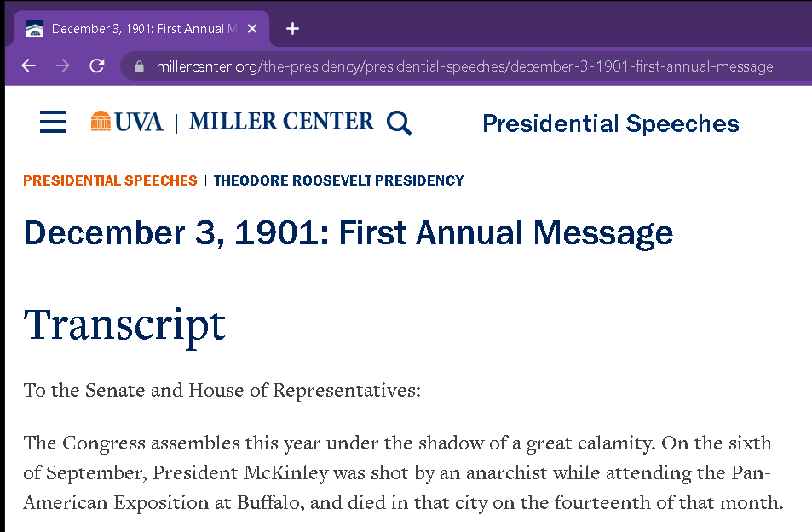
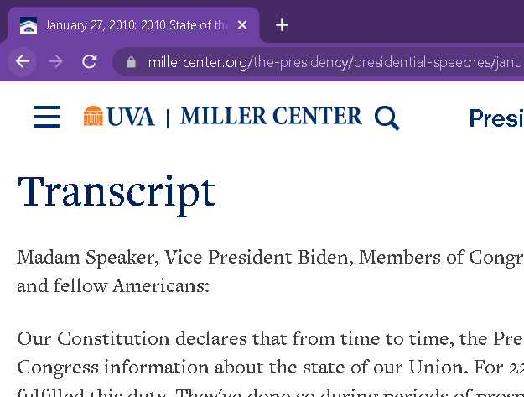
President Roosevelt and obama
Four annual speeches from each president scraped from the ‘Miller Center’ archives.
Notes:
The first four annual speeches from each of two presidents were scraped and processed using common python text analysis libraries from a jupyter notebook.
Mostly, Roosovelts speeches were twice as many words as Obama’s.

Slide 3
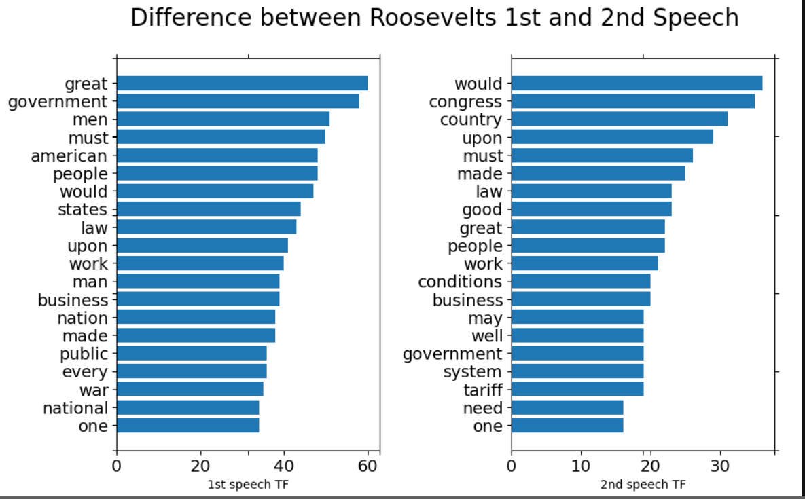
President Roosevelt (1901)
Common to all Four:
government
great
law
upon
would
Notes:
President Roosevelt’s first four annual speech's at the turn of the century were marked by several common words. As depicted in the graph here, the term frequencies from the top 20 terms from the 1st and 2nd annual speech indicate common words like ‘government’ and ‘one’
Common to all four of Roosovelt’s speeches were the words 'government', 'great', 'law', 'upon’ and the word 'would’.

Slide 4
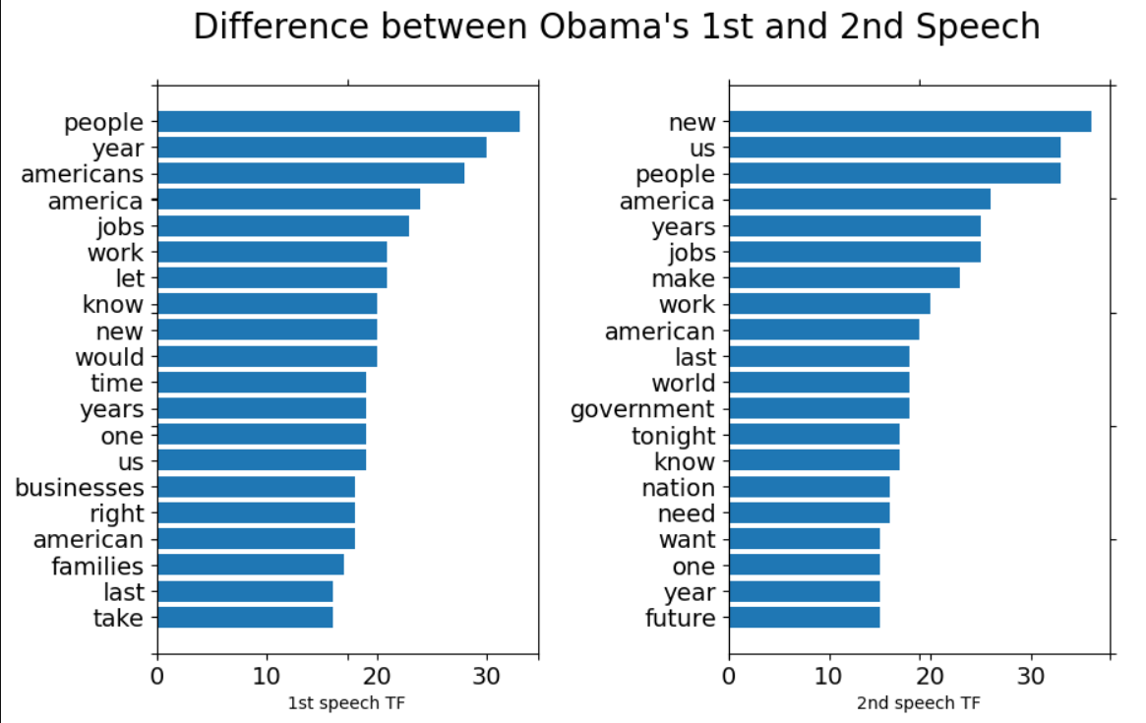
President obama (2010)
Common to all Four:
america
american
jobs
new
people
work
year
years
Notes:
President Obama’s first four annual speech’s 21st century were marked by several common words. As depicted in the graph here, the term frequencies from the top twenty terms from the 1st and 2nd annual speech indicate common words like ‘government’ and ‘one’
Common to all four of Obama’s speeches were the words ‘America’, ‘American’, ‘jobs’, ‘new’, ‘people’, ‘work’, ‘year’, ‘years’. (8 words)

Slide 5
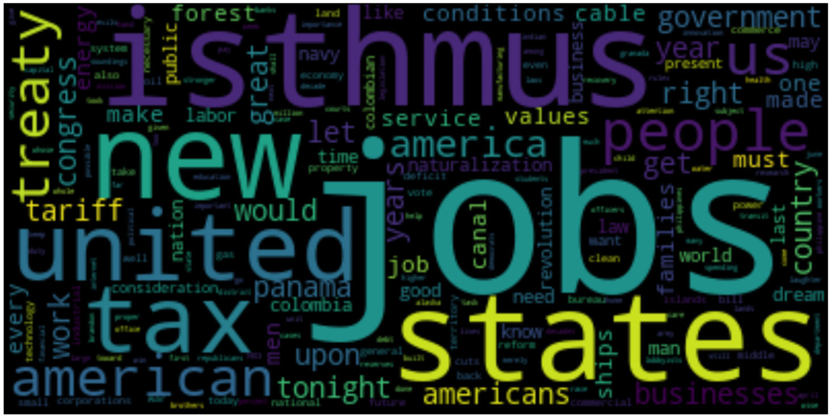
TF/IDF from all speeches
Notes:
Analysis of the TF/IDF of all the words in the corpus turned up two exciting words ‘isthmus’ and ‘jobs’. The TF/IDF was high for these two words because Obama used this work consistently, over 20 times in each speech AND President Roosevelt never used the word jobs. The second word, isthmus (narrow strip of land with sea on either side) turns up because it was used 42 times in only one Roosevelt speech and never in Obama’s speech.
The word ‘new’ was used consistently a lot in all speeches.

Slide 6
https://github.com/DD-Scott/MiniProject1

